Slide 1
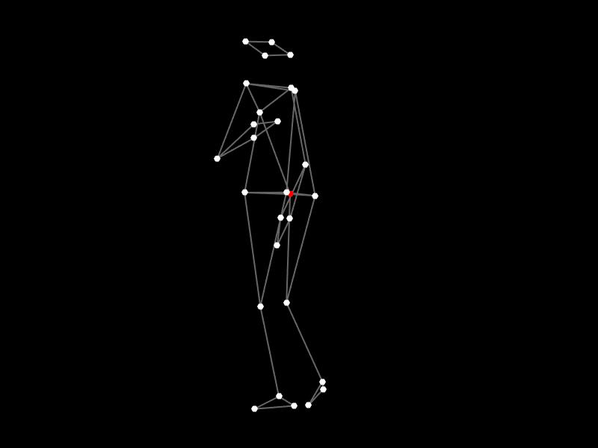
ALL MARKERS WITH MISSING DATA

Slide 2

HIPS’ MARKERS WITH MISSING DATA (ZENITHAL VIEW)

Slide 3
HIPS’ MARKERS WITH DATA FILLED USING mcfillgaps (ZENITHAL VIEW)

Slide 4
HIPS’ MARKERS WITH DATA FILLED USING mcrecovery (ZENITHAL VIEW)

Slide 5
ALL MARKERS WITH RECONSTRUCTED DATA

